Slide 1
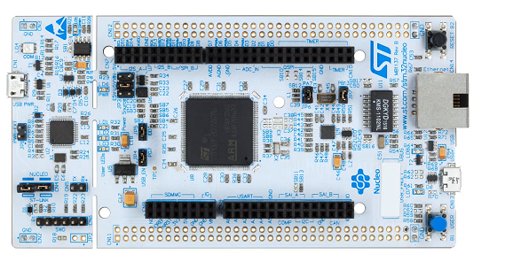
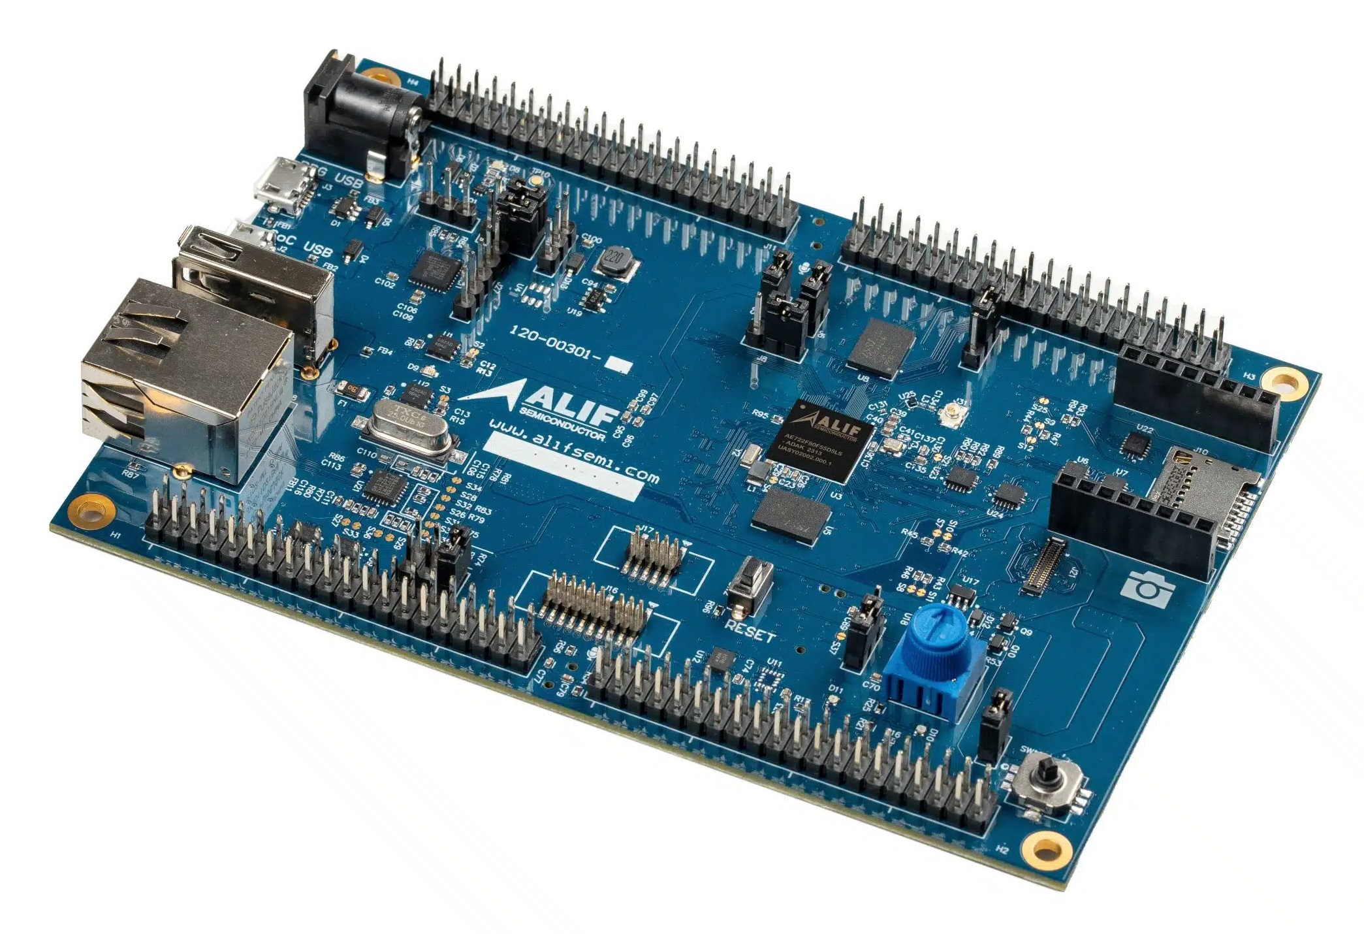
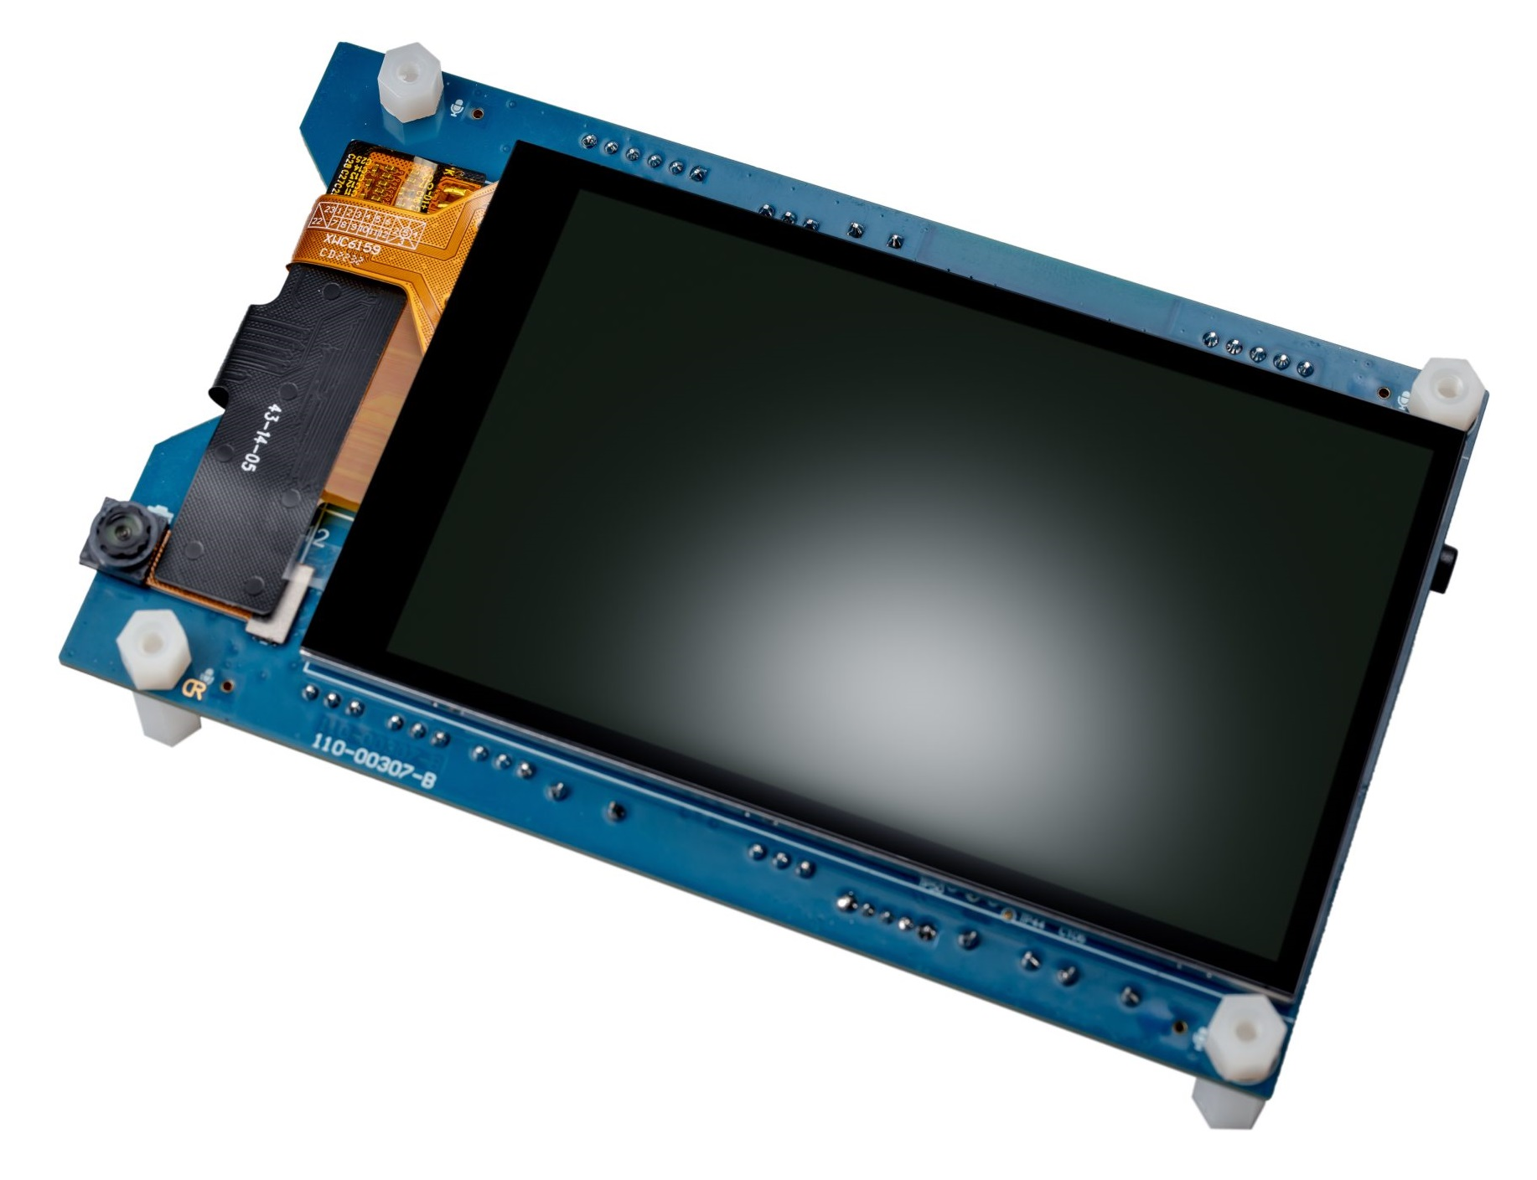
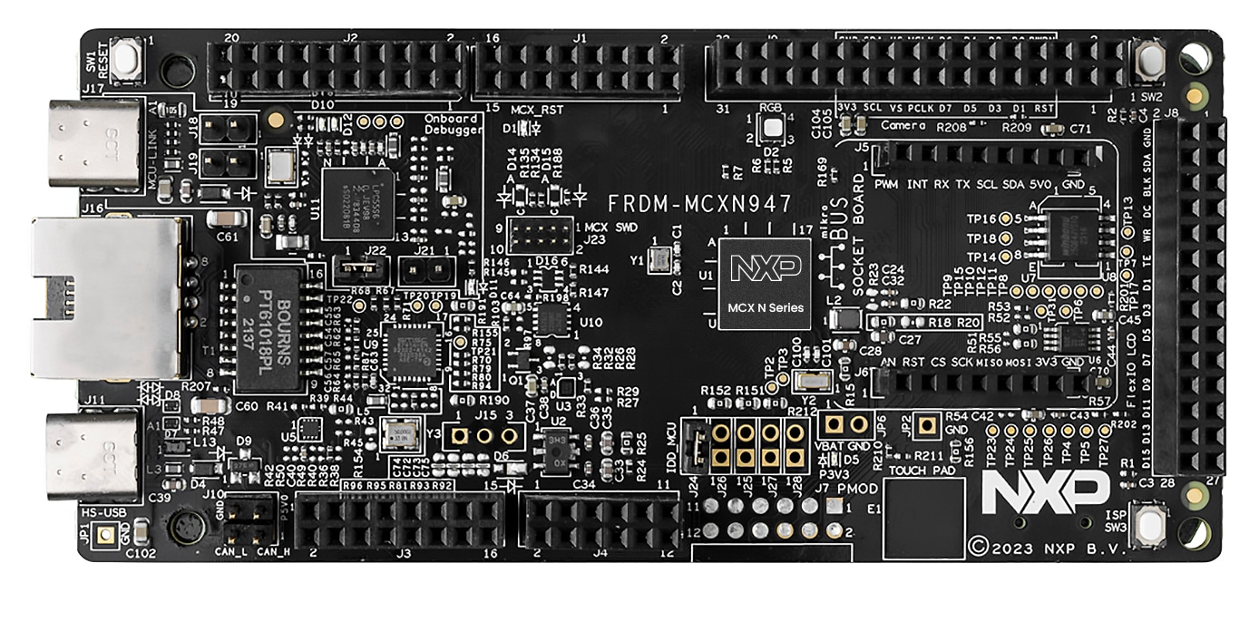
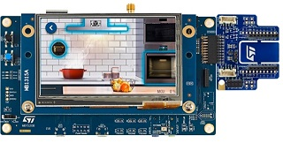
Audio Processing
Video Processing
Generic Inference Runner
Audio Classification (DSP)
Keyword Spotting
(ML Model)
Image Preprocessing
Object Detection
(ML Model)
Test Data
User Model (ML Model)
mlek_audio.csolution Example and Template for ML model development
vstream Audio
STDIO
vstream Video
vstream Video
STDIO
STDIO
kws.cproject
user.cproject
Keyword Spotting
Framework for user algorithms
Board Support Pack (BSP) A board layer with compatible driver implementations enables MLEK reference applications.
Driver APIs
Algorithm
Layer Type: Board (<board-name>.clayer.yml)
I/O driver interface

Slide 2



Cortex-M Optimized Software Flow for TensorFlow Lite Micro
User Challenges:
Verify performance after quantization
Ensure correct execution on target
Timing analysis
HOST (OFFLINE)
TARGET / DEVICE
TF Model
CMSIS-NN
Optimized Kernels
Cortex-M CPU
Quantization
TFLu Runtime
TensorFlow Lite flat buffer file

Slide 3
Ethos-U Optimized Software Flow for TensorFlow Lite Micro
User Challenges:
Verify performance after quantization
Ensure correct execution on target
Timing analysis
Analysis of Ethos-U execution flow
HOST (OFFLINE)
TARGET / DEVICE
TF Model
CMSIS-NN
Optimized Kernels
Cortex-M CPU
Quantization
Vela Compiler
(Optimize for Ethos-U NPU)
TFLu Runtime
TensorFlow Lite flat buffer file
Ethos-U Driver
Ethos-U
NPU

Slide 4
Cortex-M System
Cortex-M + Ethos-U System
TARGET / DEVICE
TARGET / DEVICE
CMSIS-NN
Optimized Kernels
Cortex-M CPU
CMSIS-NN
Optimized Kernels
Cortex-M CPU
TFLu Runtime
TFLu Runtime
Ethos-U Driver
Ethos-U
NPU

